Slide 1
Employee Data Analysis using Excel
STUDENT NAME: VARDHINI M S
REGISTER NO: 122203914
(nan Mudhalvan id - asunm1621122203914)
DEPARTMENT: III B.COM CS SHIFT-II
COLLEGE: SHRI SHANKARLAL SUNDARBAI SHASUN JAIN COLLEGE FOR WOMEN

Slide 2
PROJECT TITLE
Employee TURNOVER & FTE (Full-Time Equivalent) Analysis using Excel

Slide 3


AGENDA
Problem Statement
Project Overview
End Users
Our Solution and Proposition
Dataset Description
Modelling Approach
Results and Discussion
Conclusion
3/21/2024 Annual Review

Slide 4

PROBLEM STATEMENT
The organization is facing challenges in managing its workforce efficiently, with increasing employee turnover rates and an unclear understanding of full-time equivalent (FTE) distributions. High turnover can lead to increased recruitment and training costs, decreased productivity, and potential disruptions in operations. Additionally, inaccurate FTE analysis could result in suboptimal workforce allocation, leading to either overstaffing or understaffing, affecting both financial performance and service delivery.

Slide 5

PROJECT OVERVIEW
Project Objective:
Analyze employee turnover and Full-Time Equivalent (FTE) data to optimize workforce management and improve retention rates
Scope of Analysis:
The project will cover turnover trends (e.g., reasons for leaving, affected departments, job roles) and FTE calculations (e.g., determining staffing levels in relation to operational needs).
Focus on historical data for a specific period (e.g., last 12 months) and forecast future trends.
Data Sources:
HR data: Employee join/exit dates, reasons for leaving, department, job role, working hours.
Payroll/Finance data: Salaries, benefits, FTE contributions.
Key Metrics:
Employee Turnover Rate: Percentage of employees who leave the organization over a specific period.
FTE Calculation: Measure of total hours worked by employees relative to the hours expected for a full-time employee.

Slide 6
Tools and Methodology:
Use Excel for data analysis, including formulas, pivot tables, charts, and data visualization to interpret the findings.
Apply statistical methods to identify patterns and correlations in the data.
Stakeholders:
HR Department, Finance Department, Operations Management, Executive Leadership, and Workforce Planning Teams
Benefits:
Improved employee retention, reduced recruitment and training costs.
Enhanced workforce utilization, leading to better operational efficiency and financial performance

Slide 7

WHO ARE THE END USERS?
The end users are the listed below who would be benifited through the analysis
HUMAN RESOURCES (HR) DEPARTMENT
HR Managers and Directors: They use turnover and FTE analysis to monitor employee retention, identify trends, and address staffing issues
Recruitment Teams: Understanding turnover helps in planning recruitment strategies to fill gaps caused by employee exits.
EXECUTIVE LEADERSHIP
CEOs and COOs: They rely on employee turnover and FTE data for high-level strategic planning, understanding workforce productivity, and making organizational changes
DEPARTMENTAL MANAGERS:
FINANCE DEPARTMENT

Slide 8

OUR SOLUTION AND ITS VALUE PROPOSITION
Turnover Analysis:
Segment Data: Identify turnover trends by department, role, and tenure.
Trend Visualization: Use Excel to chart turnover patterns and identify high-risk areas.
Cause Identification: Analyse reasons for turnover to address key issues (e.g., compensation, work environment)
FTE Analysis:
FTE Calculation: Use Excel to calculate FTEs and assess workforce distribution.
Staffing Optimization: Identify overstaffed or understaffed departments and recommend resource adjustments.
Budget Alignment: Compare actual FTEs with budgeted levels to optimize financial performance
Insights and Actions:
Turnover Reduction: Propose targeted retention strategies (e.g., onboarding improvements, career development, competitive compensation).
Workforce Utilization: Recommend reallocating resources based on operational needs to balance workloads effectively

Slide 9
Dataset Description
Data are collected form the EDUNET dashboard
EMP ID
NAME
GENDER
DEPARTMENT
SALARY
SALARY RATING
START DATE
FTE
FTE RATING
EMPLOYEE TYPE
WORK LOCATION

Slide 10

THE "WOW" IN OUR SOLUTION
I used in the formulae to rate the salary of the employees & FTE *(full time equivalent)
The formulae is
=IFS(F2<=50000, "lower level", F2<=100000, "middle level", F2>100000, "upper level", TRUE, "")
And the same formulae used for FTE(full time equivalent )
3/21/2024 Annual Review
10

Slide 11
MODELLING
Data Cleaning and Preparation:
Remove duplicates and handle missing values.
Normalize data fields (e.g., standardizing date formats, categorizing reasons for leaving).
Ensure consistency in FTE and turnover metrics across datasets
Visualization:
Create Excel charts (e.g., bar charts, line graphs) to visualize turnover trends and FTE distributions.
Use pivot tables to summarize data and enable interactive analysis by stakeholders.

Slide 12
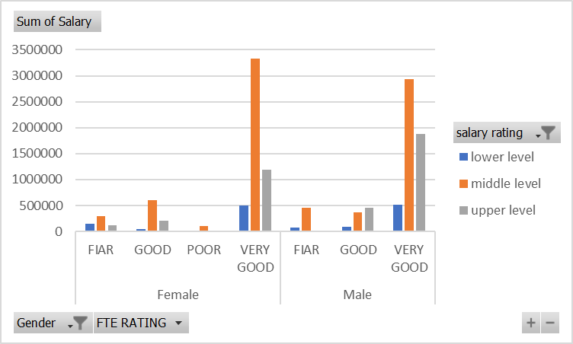
RESULTS
In conclusion, this analysis utilized pivot tables and charts in Excel to effectively present and interpret the results of our employee turnover and FTE analysis. The pivot tables enabled us to dissect the data into meaningful segments, revealing key trends and patterns. The resulting charts then visualized these insights, making complex data more accessible and comprehensible.
12

Slide 13
conclusion
In conclusion, this analysis has provided valuable insights into employee turnover rates and Full-Time Equivalent (FTE) calculations through the use of Excel. By systematically examining turnover trends and FTE metrics, we have identified key patterns and areas of concern that impact workforce stability and efficiency. The findings underscore the importance of addressing turnover proactively and optimizing staffing levels to align with organizational goals. Moving forward, it is recommended to implement targeted strategies to improve retention and adjust workforce planning based on the data-driven insights provided. This analysis not only contributes to better understanding and management of workforce dynamics but also offers a foundation for ongoing improvement. Thank you for your attention and engagement with this analysis.

